Slide 1

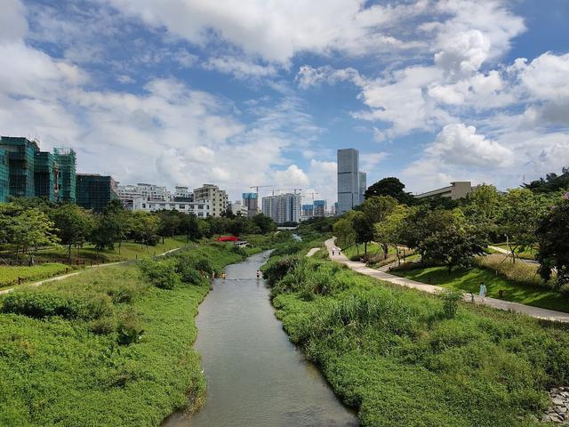
Modeling study on the impact of medical wastewater leakage
from Shenzhen University General Hospital
on Dasha River and its downstream Fisheries
CEE6314 GTSI 2022.Summer
Shuang Wu, Zilin Guo, Yingjing Miao, Yunbo Liu

Slide 2


1. Background

Slide 3
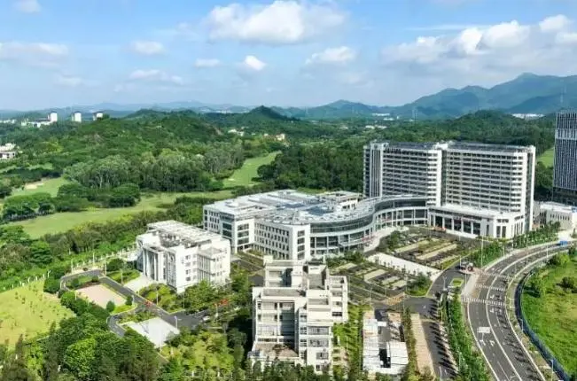
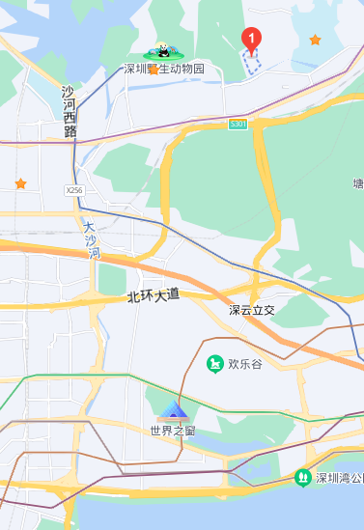
1.Backgroud
Medical waste water contains many toxic components:
Pathogenic Microbes
Organic nutrients
Disinfectant
Radioactive salt
Heavy metal
Antibiotic
Chemicals
BOD
COD
Stability of drugs
Toxic effects
(5-15 times than that of domestic wastewater)
(inhibit the biological activity of WWTP)
(endocrine disrupting compounds)

Slide 4
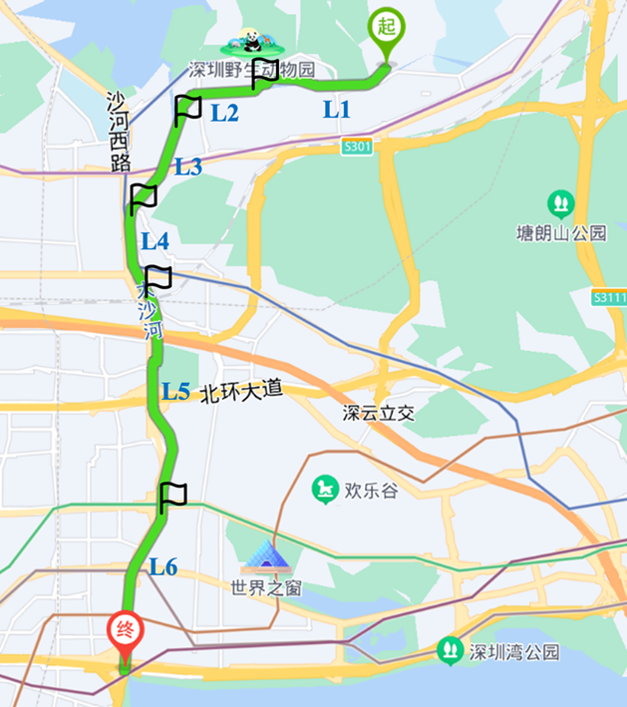
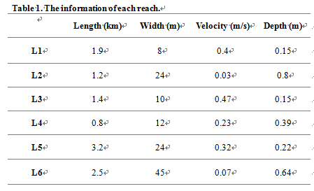
1.Backgroud
Target: to evaluate the concentration and change process of medical drugs in the Dasha River
When medical wastewater flow into the Dasha River,
Basic assumptions:
(1)A close system
(2)The leakage was continuous
(3)Divided it into six parts, according to its velocity and width
(4) Boundary: from the hospital, to the entrance to the sea

Slide 5
2. Data selection

Slide 6
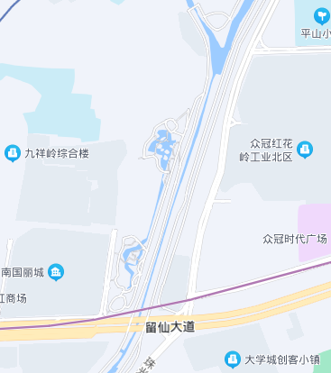
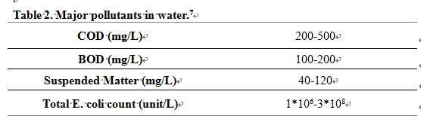
2.Data selection
Data selection:
The precipitation in Shenzhen is more concentrated from April to September.
Select the data in July: The average temperature is 27 ­ °C , total precipitation is 46.08 mm.
A univariate linear regression model with biochemical oxygen BOD as the evaluation index.
Set a storage zone in part L3. The length of the storage zone is 50m.
Check the literature to get the composition data of medical wastewater.

Slide 7
3. Select formulas, and build the model

Slide 8
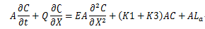
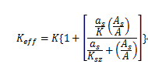
3. Select formulas, and build the model
Select formulas, and build the model:
X = the horizontal distance along the channel;
t= time;
A = the cross-sectional area;
Q = the flow discharge;
v = the mean flow velocity;
E= the longitudinal dispersion coefficient;
S=accounts for the losses and gains of the system;
C=BOD concentration;
L_{a} = the rate of addition of BOD along the reach.
As = storage zone cross-sectional area;
A = main channel cross-sectional area;
Ksz = storage zone first-order decay coefficient;
a_{s}=storage zone exchange coefficient
Overall equation:
Research on storage zone:

Slide 9
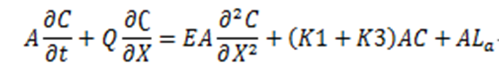
3. Select formulas, and build the model
Calculation of BOD degradation mechanism：
Assume the original BOD concentration in the Dasha River ： 2mg/L,
BOD concentration of the inflow medical wastewater： 200mg/l
The degradation of BOD shows two components in the reaction constant: K1 、 K3
BOD carbonaceous reaction rate:
K1 = 0.1 day-1 = 0.0042 h-1⁹,
The rate coefficient for the removal of BOD by sedimentation and adsorption:
K3 =0.3 day-1 = 0.0125 h-1¹⁰

Slide 10
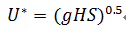
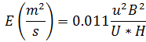
3. Select formulas, and build the model
Select formulas, and build the model:
Shear velocity:
U*= shear velocity;
S= slope of the river⁸;
g= 9.81m/s².
Through literature review, we get the general river slope of the area where Dasha River is located.
Assumed gradient along the river is always 0.003
E= the longitudinal dispersion coefficient;
u = velocity;
B = width of each reach;
H = depth of each reach.
Represent the characteristics of the river:

Slide 11
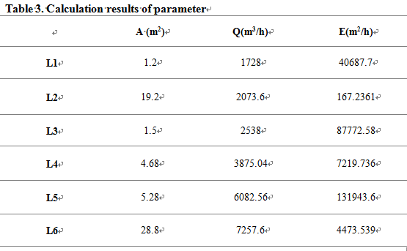
3. Select formulas, and build the model
Flow parameters of the river：
Combined with geographical data of segmented rivers, and assumptions about parameters :
Calculate the flow parameters of the river

Slide 12
4.Modelling result

Slide 13
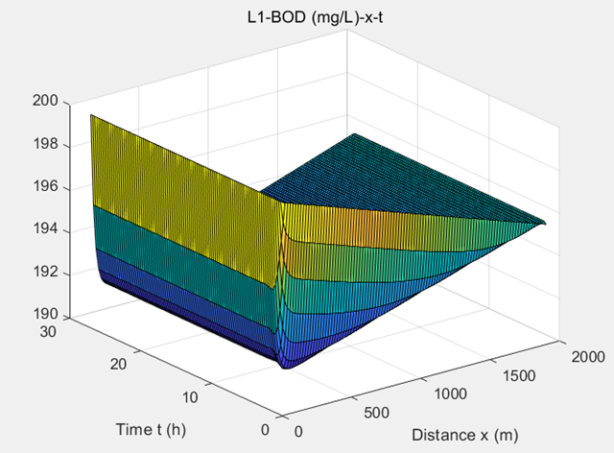
4.Modelling result
Calculate in MATALAB,
In the L1 River, get the relationship between BOD content in water and time and distance:
Figure 3. L1-BOD (mg/L)-x-t.
Use the effluent data of L1 river section for the inflow data of the next river section, and go on.

Slide 14
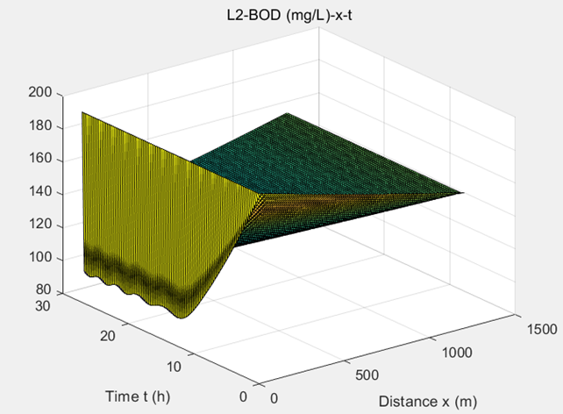
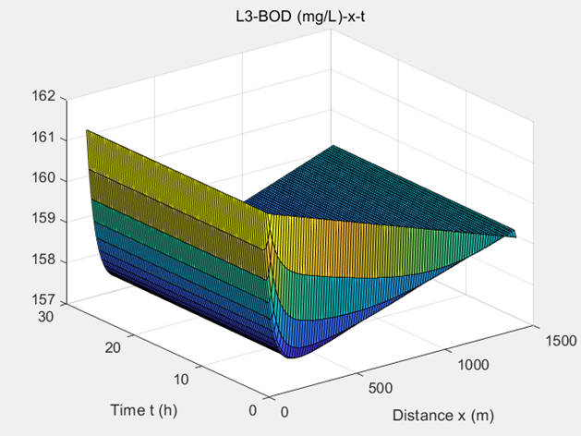
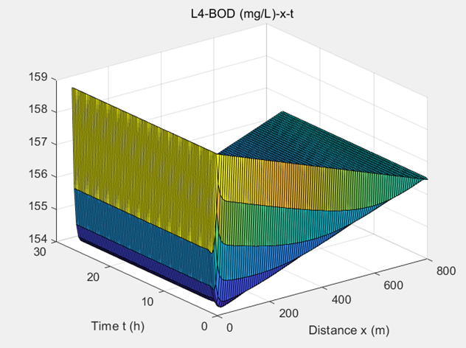
4.Modelling result
Get the data of each part similarly:
Figure 4. L2-BOD (mg/L)-x-t.
Figure 5. L3-BOD (mg/L)-x-t.
Figure 6. L4-BOD (mg/L)-x-t.

Slide 15
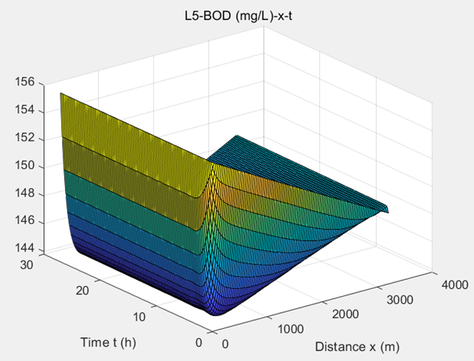
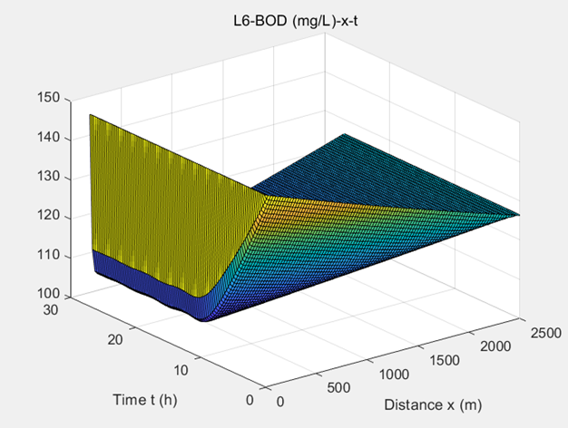
4.Modelling result
Get the data of each part similarly:
Figure 7. L5-BOD (mg/L)-x-t.
Figure 8. L6-BOD (mg/L)-x-t.

Slide 16

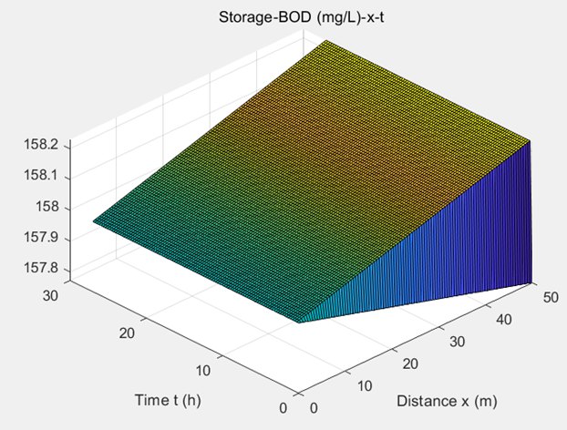
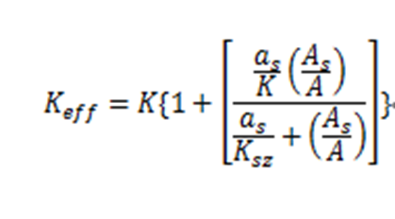
4.Modelling result
As we mentioned before, there is a storage zone in L3, so we use Keff in equation (2) to get the result.
The diagram of BOD concentration changes with time and distance is shown here.

Slide 17
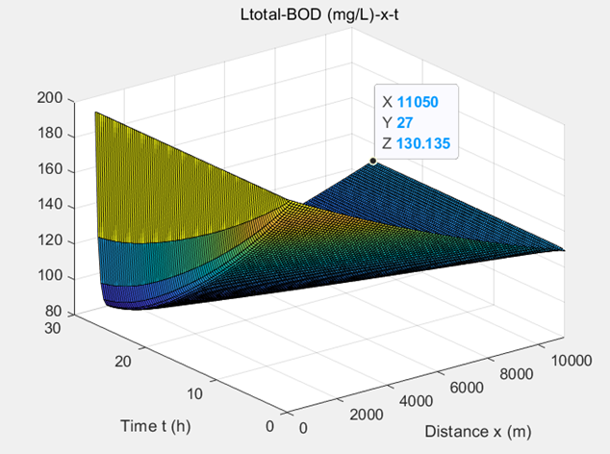
4.Modelling result
Overall Result:
Combined with the calculation of each part, the results can be obtained.
We can see the final concentration of BOD at the target destination is 130.135mg/L.
Figure 2. Total BOD (mg/L)-x-t.

Slide 18
5.Standard requirements

Slide 19
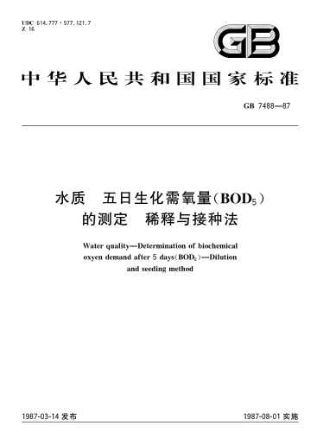
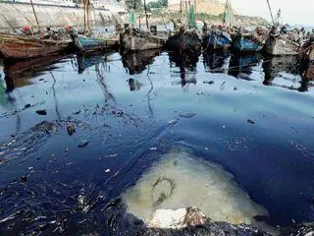
5.Standard requirements
Does the water quality meet the requirements?
According to the standard GB7488, the allowable concentration of BOD in water in fishery is 5mg/L .
BOD exceeds the standard value------ it indicates that the water quality cannot ensure the normal growth and reproduction of fish, shrimp and shellfish, and may cause harm.

Slide 20
6. Transformation Reaction : tetracycline

Slide 21
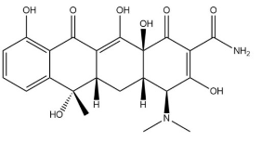
6. Transformation Reaction : tetracycline
Estimation of Transformation Reaction : tetracycline (TCs)
Tetracycline, a kind of cheap and commonly used antibiotics.
There is not much decomposition in human body, and it may reach a high content in wastewater.
The concentration of TCs in hospital wastewater can reach 100 µg / L. TCs is stable in the environment and difficult to oxidize.
Wammer, K. H., Slattery, M. T., Stemig, A. M., & Ditty, J. L. (2011). Tetracycline photolysis in natural waters: loss of antibacterial activity. Chemosphere, 85(9), 1505-1510.

Slide 22
6. Transformation Reaction : tetracycline
Degradation Methods：
(1)Adsorption
Mainly related to ion exchange.
The mineral and organic components in soil are the main adsorption points.
Hydrophobic partition, cation exchange, cation bond bridge, surface coordination chelation and hydrogen bond all play a role in adsorption.
According to Freumdlich equation, increasing humic acid will reduce the adsorption of TCs. When TC is adsorbed to the soil, it will be protected and its half-life will become longer.
(2) Biotic processes
Due to the formation of inhibitory intermediates and by-products in the degradation process, it is impossible to completely mineralize tetracycline by a single method.
Chen, X., Yang, Y., Ke, Y., Chen, C. & Xie, S. A comprehensive review on biodegradation of tetracyclines: Current research progress and prospect. Sci. Total Environ. 814, 152852 (2022).

Slide 23
6. Transformation Reaction : tetracycline
Degradation Methods：
(4) Photolysis
Tetracycline will undergo direct photolysis under sunlight.
Photolysis is very fast with a degradation rate constant at 3.61 ± 0.06 day−1.
The product of the reaction is no longer antibacterial. Major degradation product is 4a,12a-anhydro-4-oxo-4-dedimethylaminotetracycline.
(5) Advanced oxidation process:
Often used to treat tetracycline in sewage and soil.
(6) Hydrolysis
Hydrolysis of tetracycline obeys the first-order model and similar rate constant value.
When there is calcium ion, the degradation rate becomes slower, which is close to the availability adjusted first order model Hydrolysis in pH neutral solution is much faster.
Chen, X., Yang, Y., Ke, Y., Chen, C. & Xie, S. A comprehensive review on biodegradation of tetracyclines: Current research progress and prospect. Sci. Total Environ. 814, 152852 (2022).

Slide 24
3.Conclusion

Slide 25
(1)Through geographical data, Dasha River is divided into six sections, and flow analysis and BOD degradation analysis are carried out section by section.
According to the calculation results, the river moves 11.05km after 27h to reach the end of Dasha River. The final BOD concentration is 130.135mg/l.
The effluent concentration is greater than the BOD concentration suitable for fishery activities.
The leakage of medical wastewater will have a noticeable impact on the environment.
(2)Possible improvement: considering the upstream water inflow and dilution, the impact may be reduced.
(3)Taking tetracycline as an example, the degradation of stubborn chemicals involves adsorption process, biological treatment process, chemical hydrolysis, photolysis and oxidation.

Slide 26
Thank you

